Slide 1


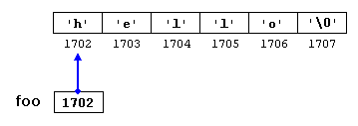
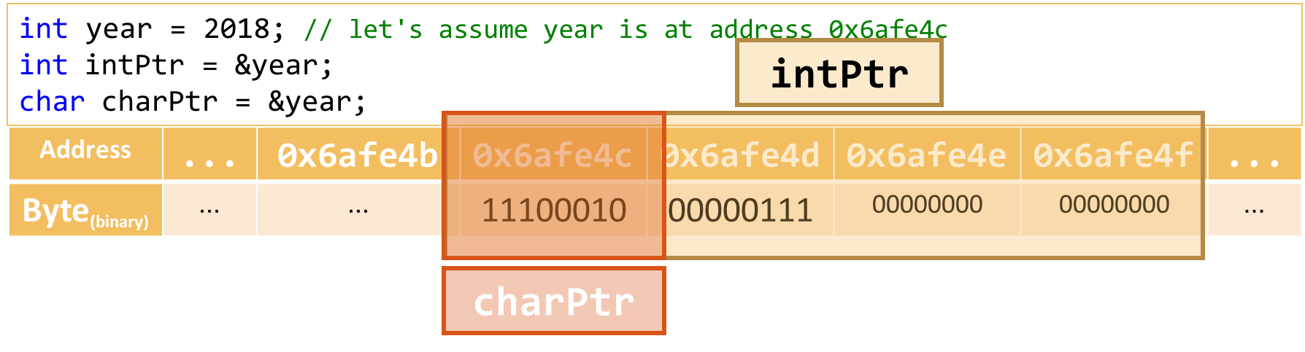
Pointers and References
References, Memory 101, Pointers Pointer Arithmetic, Usages
Zhivko Petrov
A guy that knows C++

Slide 2

Table of Contents
References
Computer Memory 101
Pointers, Referencing and Dereferencing
The NULL Pointer
Pointers and const
Pointer Arithmetic and Arrays

Slide 3
Questions
sli.do #cpp-softuni

Slide 4
References
Creation, Usages, Limitations

Slide 5
References
Identifiers assigned to the same memory as other identifiers
Type& name
Sometimes called "pseudonyms"
Assigned on declaration with variable of the same type
int original = 42;
int& reference = original;
original++; // original == 43; reference == 43
reference++; // original == 44; reference == 44
int& reference; // compilation error
int original = 42;
double& reference = original; // compilation error

Slide 6
Common Reference Usages
Re-assigning caller variables
Providing additional "return" values
void swap(int& a, int& b) {
int oldA = a;
a = b;
b = oldA;
}
int x = 13, y = 42;
swap(x, y); // x == 42, y == 13
int minValue(vector<int> numbers, int& foundAtIndex) {
foundAtIndex = 0;
for (int i = 1; i < numbers.size(); i++) {
if (numbers[foundAtIndex] > numbers[i]) { foundAtIndex = i; }
}
return numbers[foundAtIndex]; // the second parameter now contains the min index
}

Slide 7
Common Reference Usages
Modifying caller's objects
NOTE: not re-assigning the entire object, but changing its fields
void removeNegative(std::list<int>& numbers) {
auto i = numbers.begin();
while (i != numbers.end()) {
if (*i < 0) {
i = numbers.erase(i);
}
else {
i++;
}
}
}
list<int> values{ 1, -69, -4, 42, -2, 13, -9 };
removeNegative(values); // values{ 1, 42, 13 }

Slide 8
Modifying Parameters
LIVE DEMO

Slide 9
const References
const references can only be read, not written
const Type& name
Used to improve performance for object parameters:
Using a reference avoids copying the entire object
Using const prevents function from modifying the original
int original = 42;
const int& reference = original;
original++; // original == 43; reference == 43
reference++; // compilation error

Slide 10
const Reference Parameters – Example
Using reference prevents copying the vector
Marking it const prevents accidental editing
void printZeroIndices(const std::vector<int>& numbers) {
for (int i = 0; i < numbers.size(); i++) {
if (numbers[i] == 0) { std::cout << i << " "; }
}
}
void printZeroIndices(const std::vector<int>& numbers) {
...
if (numbers[i] = 0) { // accidental "=" gives compilation error
...
}

Slide 11
References for Performance
LIVE DEMO

Slide 12
Quick Quiz
TIME:
What will the following code do?
cause a compile-time error
cause a runtime error due to index being out of bounds
summon demons
behavior is undefined
vector<int>& generateRoots(int toNumber) {
std::vector<int> roots;
for (int i = 0; i < toNumber; i++) {
roots.push_back(sqrt(i));
}
return roots;
}
int main() {
cout << generateRoots(100)[4] << endl;
}

Slide 13

C++ Pitfall: References to Variables that were Freed from Memory
SO, YOU'RE GOING TO RETURN A REFERENCE
TO A LOCAL VARIABLE TO AVOID COPYING
AND IMPROVE PERFORMANCE?
If a variable goes out of scope, its memory is returned to the system.
References to it are invalidated.
Hence, we can't use a reference to a function's local variable outside the function.
TELL ME MORE ABOUT HOW YOU'RE GOING
TO READ AN OUT-OF-SCOPE VARIABLE
THROUGH THAT REFERENCE

Slide 14
Reference Limitations
If original variable goes out of scope, reference is undefined
Can't change to reference other variable
Initialized on creation – in class, must be set in initializer list
class LetterFilter {
const std::string& s; int index;
public:
LetterFilter(const std::string& s)
: s(s), index(0) { }
char nextLetterOrNull() {
while (index < s.size() && !isalpha(s[index])) {
this->index++;
}
if (index == s.size()) { return 0; }
letter = s[index]; this->index++;
return s[index];
}
};
class LetterFilter {
const std::string& s; int index;
public:
LetterFilter(const std::string& s) {
// compilation error, no initializer
// for reference this->s
this->s = s;
this->index = 0;
}
...
};

Slide 15
Reference Limitations
LIVE DEMO

Slide 16
Computer Memory 101
Memory Structure, Variables in Memory

Slide 17
What Do We Call Memory?
In computer science, memory usually is:
a continuous, numbered – aka addressed – sequence of bytes
storage for variables and functions created in programs
random-access – equally fast accessing 5th and 500th byte
addresses numbered in hexadecimal, prefixed with 0x
Address | 0x0 | 0x1 | 0x2 | ... | 0x6afe4c | ...
Byte_{(binary)} | 00001101 | 00101010 | 01000101 | ... | 00000011 | ...

Slide 18
Memory Usage by Variables
A primitive data type takes up a sequence of bytes
char is 1 byte, 1 address – often used for reading byte by byte
Other types & arrays use consecutive bytes, e.g. 4-byte int:
char alpha = 'A'; // let's assume alpha is at address 0x6afe4c
Address | ... | 0x6afe4b | 0x6afe4c | ... | ... | ... | ...
Byte_{(binary)} | ... | ... | 01000001 | ... | ... | ... | ...
int year = 2018; // let's assume year is at address 0x6afe4c
Address | ... | 0x6afe4b | 0x6afe4c | 0x6afe4d | 0x6afe4e | 0x6afe4f | ...
Byte_{(binary)} | ... | ... | 11100010 | 00000111 | 00000000 | 00000000 | ...

Slide 19
Getting Addresses of Variables in C++
Prefix operator& returns a variable's address
int x = 42; cout << &x; // prints e.g. 006AFE4C
Functions also have addresses – where their code is in memory
void f() {}
int main() {
int x = 42;
auto addressX = &x;
cout << x << " at " << addressX << endl;
cout << "f()" << " code at " << &f << endl;
return 0;
}

Slide 20

Getting Addresses in C++
CAN I HAVE
YOUR ADDRESS?
SAY THE
MAGIC WORD
&
0x45
LIVE DEMO

Slide 21
Array Address Values
C++ Array – a Type, a start address and a length
Index i is at address: start + i * sizeof(Type)
array, it's address, and first element address are the same
int arr[] = { 2018, 310 }; // assume &arr[0] == 0x6afe4c
Address | ... | 0x6afe4b | 0x6afe4c…0x6afe4f |  |  |  | 0x6afe50…0x6afe53 |  |  |  | 0x6afe554
Byte_{(binary)} | ... | ... | 11100010 | 00000111 | 00000000 | 00000000 | 00110110 | 00000001 | 00000000 | 00000000 | …
Value | ... | ... | 2018 |  |  |  | 310 |  |  |  | ...
cout << arr << " " << &arr << " " << &arr[0]; // 006AFE4C 006AFE4C 006AFE4C
cout << &arr[1]; // 006AFE50

Slide 22
Addresses Are Integer Numbers
We can store an address in size_t position;
int might be small – a 4-byte int can only "address" 4GB RAM
We can change position to indicate another address
But how can we change the value (bytes) at that address?
What type does the operator& return?

Slide 23
Pointers
Using and Representing Memory Addresses

Slide 24
A Memory-Address Type
C++ Pointers – store and can access a memory address
Type* name
Type – the type of value the pointer "points to"
A pointer is to memory what an index is to an array
char a = 'A';
char* addressA = &a;
int x = 42;
int* addressX = &x;

Slide 25
Referencing and Dereferencing
"Referencing" – setting what a pointer points to
"Dereferencing" – operator* – access memory, not pointer
operator-> – access member of pointed object
int a = 42, b = 13; // let's assume &b == 0x69fef4
int* ptr = &a; // points to a
ptr = &b; // points to b
int a = 42; int* ptr = &a;
*ptr = 7 // a is now 7
cout << *ptr; // prints 7
string s = "world"; string* ptr = &s;
ptr->insert(0, "hello "); // makes s == "hello world"

Slide 26
Referencing and Dereferencing
LIVE DEMO

Slide 27
Quick Quiz
TIME:
What will the following code print?
43
42
there will be a runtime error
behavior is undefined
int number = 42;
int* ptr = &number;
*ptr++;
std::cout << *ptr << std::endl;

Slide 28
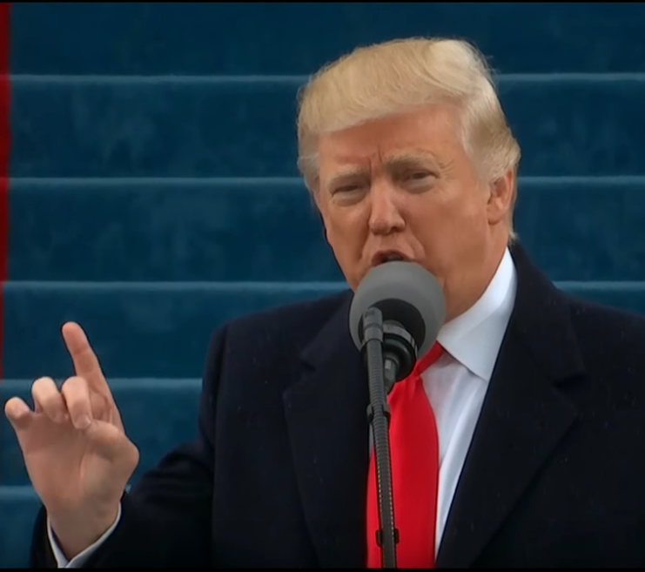
C++ Pitfall: Incrementing Pointer Instead of Pointed Object
INCREMENT FIRST
operator++ has higher precedence, and is applied to the pointer, then the dereference operator executes on the old pointer value.
On the next dereference, we could get an error, or a "random" value – undefined behavior
Use brackets to apply operator++ over the pointed memory: (*number)++
INCREMENT FIRST

Slide 29
The NULL Pointer
Special pointer value of 0, NULL or nullptr (C++11)
Dereferencing is undefined behavior
Indicates a lack of value
E.g. "find" function returning nullptr when no result found
int* findFirstNegativePtr(int numbers[], int length) {
for (int i = 0; i < length; i++) {
if (numbers[i] < 0) {
return &numbers[i];
}
}
return nullptr;
}
int* negativePtr = findFirstNegativePtr(numbers, 4);
if (negativePtr != nullptr) { cout << *negativePtr; }
else { cout << "no negative numbers" << endl; }

Slide 30
Exercise 1: FollowPointers
You are given the following main.cpp file and a Node.h file
main.cpp declares a function int getSumFrom(Node* node)
The Node.h file defines what a Node is
Create a FollowPointers.h that implements the function
The function should calculate the sum
Of the value fields, from the provided node
Moving by going to the next field, until nullptr is reached
Write #include "Node.h" in your file to use the Node code

Slide 31
Pointers and const
Constant Pointers and Constant Data

Slide 32
Pointers and const
Two things can change for a pointer
The pointed address
The data at the address
What do the last 2 in the table match logically?
Pointer | Memory editable? | Address editable?
Type * ptr | YES | YES
const Type * ptr | NO | YES
Type * const ptr | YES | NO
const Type * const ptr | NO | NO

Slide 33
Pointers to const Data
Used similarly to const references
Pointer usage avoids object copy – only the address is copied
const on the Type prevents changing the pointed data
void printZeroIndices(const std::vector<int>* numbers) {
for (int i = 0; i < numbers->size(); i++) {
if (numbers->at(i) == 0) { std::cout << i << " "; }
}
}
vector<int> numbers{ 1, 0, -2, 7, 0, 10, -100, 42 };
printZeroIndices(&numbers);

Slide 34
Pointers to const Data
LIVE DEMO

Slide 35
Pointer Arithmetic and Arrays
Type-Defined Pointer Calculations

Slide 36
Pointer Type Significance
Pointer operations are based on their Type
Reading accesses exactly sizeof(Type) bytes
Writing sets exactly sizeof(Type) bytes
int year = 2018; // let's assume year is at address 0x6afe4c
int* intPtr = &year;
char* charPtr = (char*)&year;
intPtr
Address | ... | 0x6afe4b | 0x6afe4c | 0x6afe4d | 0x6afe4e | 0x6afe4f | ...
Byte_{(binary)} | ... | ... | 11100010 | 00000111 | 00000000 | 00000000 | ...
charPtr

Slide 37
Pointer Arithmetic with Integers
Typed pointers support integer addition/subtraction
For a Type* pointer with address x
pointer + value calculates x + sizeof(Type) * value
pointer - value calculates x - sizeof(Type) * value
int number = 42; // assume &number == 0x6afe4c
int * intPtr = &number; char * charPtr = (char*)&number;
// NOTE: casting the char* to int* to avoid printing as a string
cout << intPtr << " " << (int*)charPtr << endl; // 0x6afe4c 0x6afe4c
intPtr++; charPtr++;
cout << intPtr << " " << (int*)charPtr << endl; // 0x6afe50 0x6afe4d

Slide 38
Pointers as Arrays
Array operator[] is actually defined with pointer arithmetic
For an array arr and an integer i:
arr[i] compiles to *(arr + i)
Array parameters in functions "degenerate" into pointers
void f(int arr[], int length) is the same as void f(int* arr, int length)
int arr[3]{ 13, 42, 69 };
int* p = arr;
p[1] = -42;
cout << arr[1]; // -42
cout << *(p + 1); // -42
cout << p[1]; // -42

Slide 39
Quick Quiz
TIME:
What will the following code print?
42
there will be a compilation error
there will be a runtime error
behavior is undefined
int arr[3]{ 13, 42, 69 };
cout << 1[arr] << endl;

Slide 40
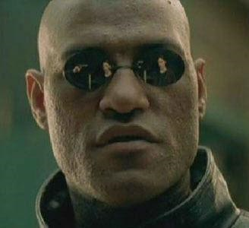
C++ Fun Fact: Can Switch Index and Array in oPerator[]
INCREMENT FIRST
WHAT IF I TOLD YOU
Array operator[] is just pointer arithmetic.
*(a + b) is the same as *(b + a), so operator[] works even if you switch the index and array. But don't ☺
OPERATOR[] FOR ARRAYS IS POINTER ARITHMETIC, SO IT DOESN'T CARE IF YOU SWITCH THE INDEX AND THE ARRAY
INCREMENT FIRST

Slide 41

Summary
References allow setting new identifiers for existing variables
Computer memory is essentially an array of bytes
Variables occupy consecutive bytes of memory
Pointers are to memory what indices are to arrays
Used to read/write memory
Can change to point to other memory
Pointer arithmetic allows pointers to work like arrays

Slide 42







Pointers and References
https://softuni.bg/courses/

